Slide 1
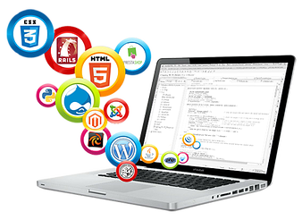
Chapter One Introduction
CS322: Web Design and Development 2021
By:-Zelalem Abera MSC(zolaab12@gmail.com)
Notes:
NOTE:
To change the image on this slide, select the picture and delete it. Then click the Pictures icon in the placeholder to insert your own image.

Slide 2
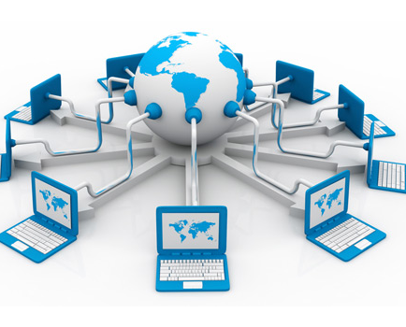
1.Internet
Notes:
NOTE:
To change the image on this slide, select the picture and delete it. Then click the Pictures icon in the placeholder to insert your own image.

Slide 3
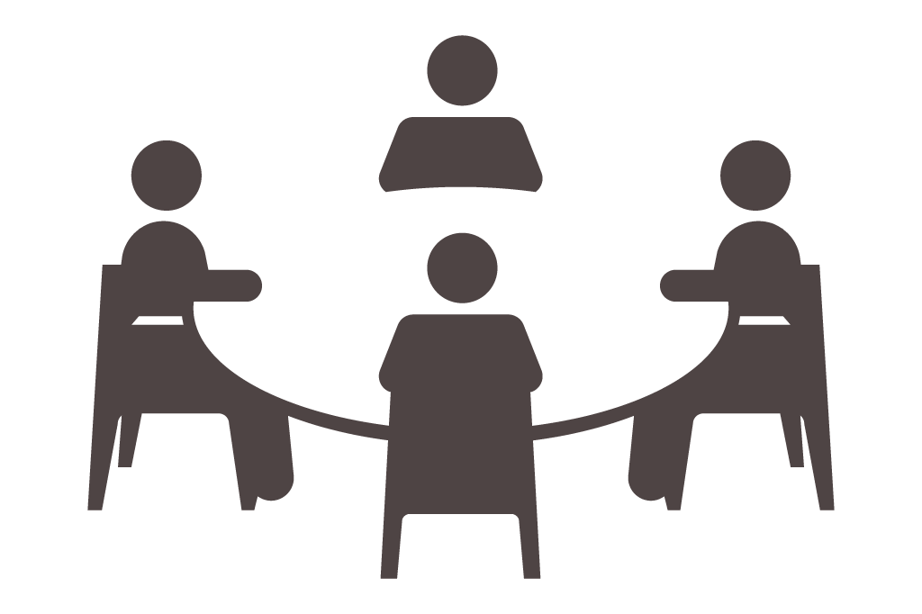
Discussion
What is a Network?
What is the Internet?
A network is a collection of computers, servers, mainframes, network devices, peripherals, or other devices connected to one another to allow the sharing of data
Excellent example of a network is the Internet, which connects millions of people all over the world.

Slide 4
1.What is Internet?
It is the largest network in the world that connects hundreds of thousands of individual networks all over the world.
A means of connecting a computer to any other computer anywhere in the world via dedicated routers and servers.
When two computers are connected over the Internet, they can send and receive all kinds of information such as text, graphics, voice, video, and computer programs.

Slide 5
Who owns the internet?
No one!
Although several organizations in the world over collaborate in its functioning and development. The high-speed, fiber-optic cables (called backbones) through which the bulk of the Internet data travels are owned by telephone companies in their respective countries.

Slide 6
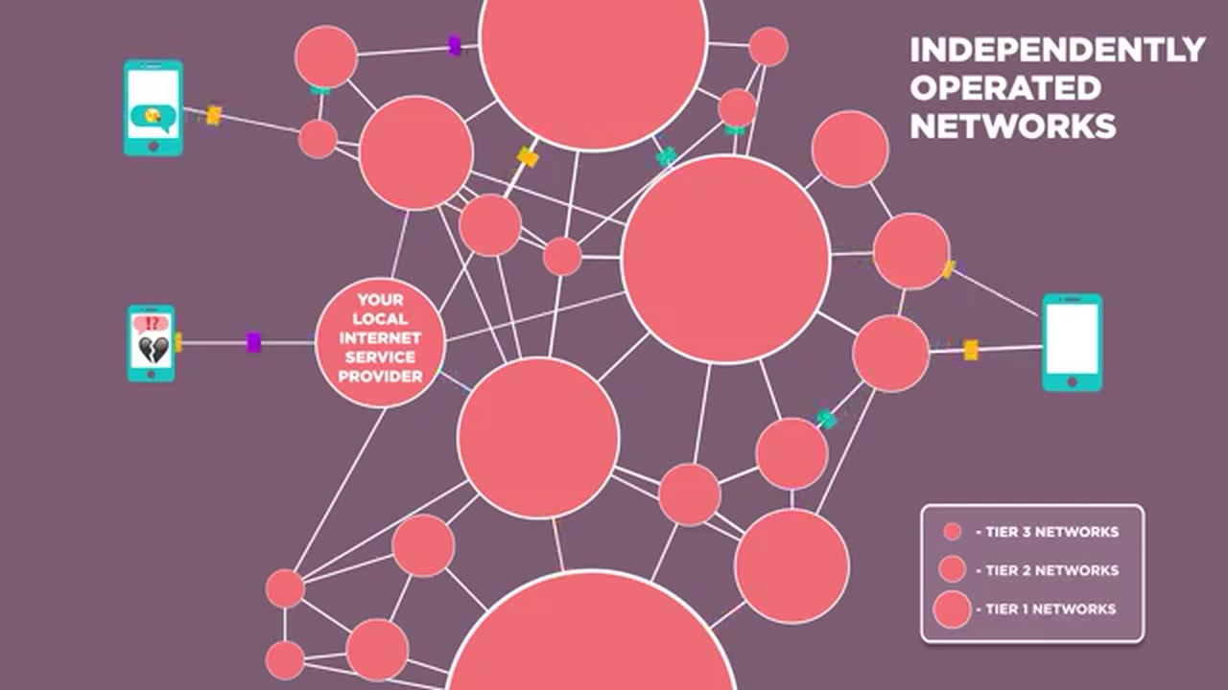
1.Internet…
An Internet is a global network of networks.
The internet is made up of independently operated networks(Fully distributed) and there is no central control which decides how packets(data) are routed, who connects with whom etc..
All business decisions are made independently by the operators.

Slide 7
1.Internet…
The utility of the internet is any device can connect to any device ,just like you want to make a phone calls to any other telephone in the world.
It was originally developed by the Department of defense, this lack of centralization made it less vulnerable to wartime or terrorist attacks.
Everyone will find that they use the internet in one way or another whether it is to research some information of simply talk to friends

Slide 8
What does the Internet do?
The Internet has one very simple job: to move computerized information (known as data) from one place to another. That's it!
The machines that make up the Internet treat all the information they handle in exactly the same way.
In this respect, the Internet works a bit like the postal service. Letters are simply passed from one place to another, no matter who they are from or what messages they contain

Slide 9
What does the Internet do?
All information is handled equally and passed on in exactly the same way. Because the Internet is so simply designed, people can easily use it to run new "applications"—new things that run on top of the basic computer network.
That's why, when two European inventors developed Skype, a way of making telephone calls over the Net, they just had to write a program that could turn speech into Internet data and back again. No-one had to rebuild the entire Internet to make Skype possible.

Slide 10
Why it is used?
The Internet is used for many different things such as:
Talking to friends – using programs such as Skype and Viber.
Online shopping – buying items from the internet without leaving your home using sites such as www.ebay.com
Watching Videos – using websites such as www.youtube.com
Research – using search engines such as www.google.com
Downloading/listening to music – using programs such as lime wire or sites such as www.ituens.com

Slide 11
Audience
The intended audience for the internet is anyone and everyone in the world who has access to a computer, there is no limit to the information that can be found on the internet.
The internet is used widely by the audience, mostly it used for researching subjects and talking online. However it has many other uses, one advantage of the internet is that it can be used for advertising products and companies. If you put an advert for a product on a site that is visited regularly it will become more popular.
The audience uses the internet for personal use to make their life easier and faster. The internet can enable the audience to find information within minutes and also allows them to talk to people all over the world wherever they are.

Slide 12
How does it affect the audience?
It affects the audience in a good way because it makes their lives easier and less problematic.
It enables them to do well in school and in work as they can access information and advice easily.
However it can also change a person in the way they think and their lives in general, as the internet allows them to access anything from anywhere in the world and this isn’t always a good thing as extreme violence and other bad behaviors are promoted.

Slide 13
Advantages and Disadvantages
The internet has many more advantages than it does disadvantages according to researches
Advantages:
Allows easy and quick access to information
Enables user to access files and information from any computer, anywhere in the world
People can check financial information, purchase products, talk to people and much more online
Downloading music – quick and easy
User can send information quickly form computer to computer

Slide 14
Advantages and Disadvantages…
Advantages:
E-Mail
Voice and Video Conferencing
E-Commerce
Information browsing
Search the web addresses for access through search engine
Chatting and many more…

Slide 15
Advantages and Disadvantages…
Disadvantages:-
It promotes violence and bad behavior within society, as it contains violent videos and other disturbing images.
It can encourage negative activities such as pornography and pedophilia, these things can now be explored more openly due to internet
It stops children from going out, as they wish to stay home and use the internet to talk to friends etc.
Theft of personal information such as name, address, credit card number etc.
Virus threats - nothing but a program which disrupts the normal functioning of your system.
Spamming - refers to receiving unwanted e-mails in bulk, which provide no purpose and needlessly obstruct the entire system.

Slide 16
How to access the Internet?
To access the Internet, an existing network need to pay a small registration fee and agree to certain standards based on the TCP/IP (Transmission Control Protocol/Internet Protocol) reference model.
Each organization pays for its own networks and its own telephone bills, but those costs usually exist independent of the internet.
The regional Internet companies route and forward all traffic, and the cost is still only that of a local telephone call.

Slide 17
How to access the Internet?
Many schools and businesses have direct access to the Internet using special high-speed communication lines and equipment.
Students and employees can access through the organization’s local area networks (LAN) or through their own personal computers.
Another way to access the Internet is through Internet Service Provider (ISP).

Slide 18
Internet Service Provider (ISP)
A commercial organization with permanent connection to the Internet that sells temporary connections to subscribers.
Examples:
ETC,Prodigy, America Online, Microsoft network, AT&T Networks.

Slide 19


Slide 20
Wake up Quiz
How do you define the internet?
Give one Advantage of the internet?
Give one Disadvantage of the internet?
The internet is centralized true/false?
The intended audience for the internet is ________?

Slide 21
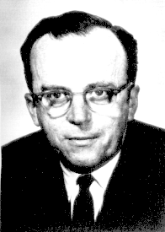
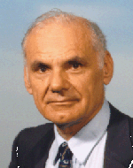
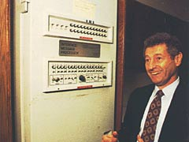
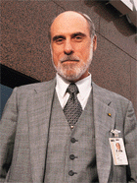
2.History of the Internet
Notes:
NOTE:
To change the image on this slide, select the picture and delete it. Then click the Pictures icon in the placeholder to insert your own image.

Slide 22
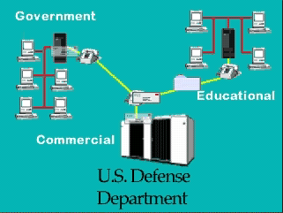
History of the Internet
Three Major Players in Internet History

Slide 23
Fun Facts
Early 90s terms which are changed because of internet
Surfing
search for a perfect wave
Mail
only delivered by the post office
Online
waiting behind someone at the movie theater
Server
waitress at your favorite café.

Slide 24
History of the Internet
The creation of the Internet is dependent on mankind’s earlier innovations
1836 - Telegraph by Cooke and Wheatstone
Revolutionized human (tele)communications.
Morse Code a series of dots and dashes used to communicate between humans. This is similar to how computers communicate via (binary 0/1) data today. Although it is much slower!!
1858-1866 - Transatlantic cable. Allowed direct instantaneous communication across the Atlantic. Today, cables connect all continents and are still a main hub of telecommunications
1876 - Telephone. Alexander Graham Bell Exhibits.
Telephones exchanges provide the backbone of Internet connections today.
Modems provide Digital to Audio conversions to allow computers to connect over the telephone network.

Slide 25

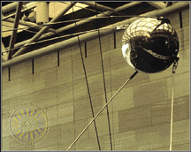
History of the Internet
Political Events
1940’s to 1980’s - U.S. vs. Soviet Cold War
1957 - U.S.S.R. launches Sputnik. The US forms the Advanced Research Projects Agency (ARPA) within the Department of Defense (DoD) to build US skills in computer technology.
The start of global telecommunications. Satellites play an important role in transmitting all sorts of data today.

Slide 26
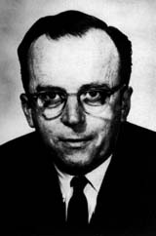
History of the Internet
ARPA Created
1957 - In response, US forms the Advanced Research Projects Agency (ARPA) within the Department of Defense (DoD) to establish US lead in science and technology applicable to the military.
1962 - Dr. J.C.R. Licklider was chosen to head ARPA's research in improving the military's use of computer technology.
Licklider was a visionary who sought to make the government's use of computers more interactive.
moved ARPA's contracts from the private sector to universities and laid the foundations for what would become the ARPANET.

Slide 27
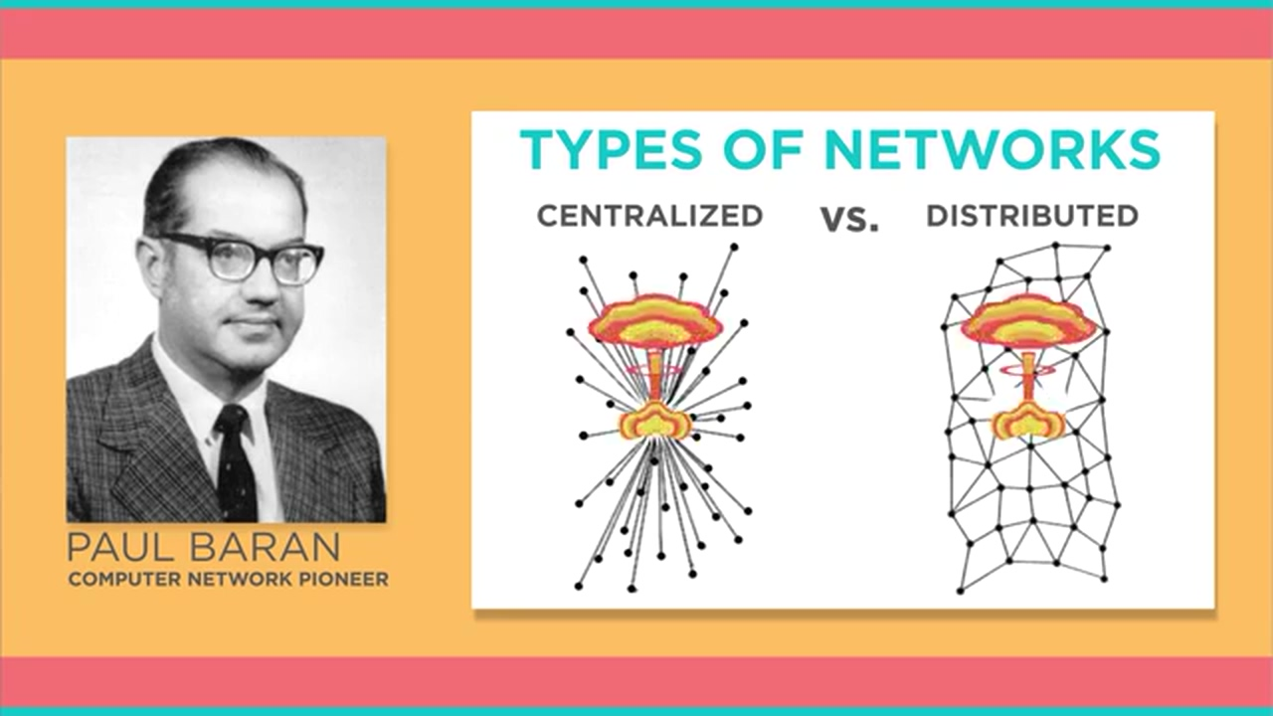
History of the Internet..

Slide 28
History of the Internet
Packet-Switching is Key
1962-1968 - Packet-switching (PS) networks developed
The Internet relies on packets to transfer data.
Data is split into tiny packets that may take different routes to a destination.
The origin is military : for utmost security in transferring information of networks (no single outage point).
More than one route available -- if one route goes down another may be followed.
Networks can withstand large scale destruction (Nuclear attack - This was the time of the Cold War).

Slide 29
History of the Internet
The Birth of the Internet
1969: The ARPANET computer network is launched, initially linking together four scientific institutions in California and Utah
In 1969 ARPA developed a special computer called the Interface Message Processor(Honeywell 516 mini computer with 12K of memory developed by Bolt Beranek and Newman, Inc. (BBN) )
The first communications were between a research center at the University of California at Los Angeles and a center at the Stanford Research Institute.
The plan was unprecedented: Kleinrock, a pioneering computer science professor at UCLA, and his small group of graduate students hoped to log onto the Stanford computer and try to send it some data

Slide 30
History of the Internet
The first program used by ARPANET was the Network Control Program. In 1983 it was replaced by TCP/IP internet protocol which became the most widely used network protocol in the world.
In 1990 ARPANET was transferred to NSFNET (National Science Foundations net) which was then connected to the CSNET (Computer Science net) this linked Universities around North America.
It was then connected to the EUNET (European network) that connected research centers in Europe.

Slide 31



History of the internet
Steve Crocker
developed ARPANET network protocol
Jon Postel
Mike Wingfield
Vinton Cerf
developed Domain Name System, FTP, Telnet, and the Internet Protocol.
Wingfield built the hardware interface between the UCLA computer and the first IMP
develop TCP/IP
Bill Naylor

Slide 32


History of the internet
E-mail
Program developed by Ray Tomlinson in 1972
@ symbol was introduced
1973 -75% of the traffic was E-mail

Slide 33
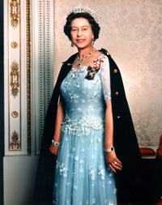
History of the internet
1973 - Global Networking becomes a reality
First international connections to the ARPANET: University College of London (England) and Royal Radar Establishment (Norway)
1974 - Packets become mode of transfer
Transmission Control Program (TCP) specified. Packet network Intercommunication -- the basis of Internet Communication.
Telenet, a commercial version of ARPANET, opened -- the first public packet data service.
1976 - Networking comes to many
Queen Elizabeth sends out an e-mail.

Slide 34
History of the internet
1982 - TCP/IP defines future communication •DCA and ARPA establishes the Transmission Control Protocol (TCP) and Internet Protocol (IP), as the protocol suite, commonly known as TCP/IP, for ARPANET.
Leads to one of the first definitions of an Internet as a connected set of networks, specifically those using TCP/IP.
1983 - Internet gets larger
Name server developed.
There is such a large number of nodes that its hard to remember exact paths
Use meaningful names instead.

Slide 35
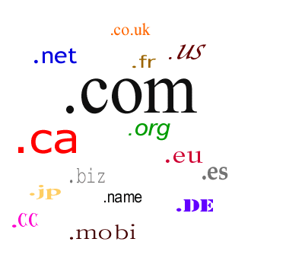
History of the internet
Domain Name
In 1984, the development of domain name services introduced to people
To easily find and identify computers linked to the internet

Slide 36
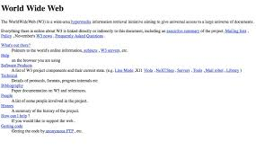
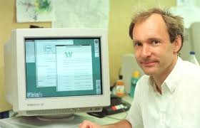
History of the internet
The World Wide Web
In 1990, Tim Berners-Lee coined the term
It saved the internet
Created three things necessary for a working web
First web server
First web browser called worldwideweb later known as NEXUS,but doesn’t display graphics
Web page

Slide 37
History of the internet
1990 and on
Fueled by the popularity of the web, the use of the internet exploded after 1990, this forced the US Government to turnover management of the net to independent organizations beginning in 1995.
That brings us to the modern day use of the World Wide Web (www.)

Slide 38
History of the internet
WWW
In 1992, a group of students and researchers at the University of Illinois developed a sophisticated browser that they called Mosaic, later known as Netscape.
It offered a user-friendly way to search the Web: like allowing users to see words and pictures on the same page for the first time and to navigate using scrollbars and clickable links.
That same year, Congress decided that the Web could be used for commercial purposes. As a result, companies of all kinds hurried to set up websites of their own, and e-commerce entrepreneurs began to use the Internet to sell goods directly to customers.

Slide 39
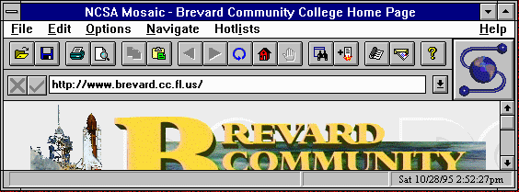
History of the internet
1993 - The WWW Revolution truly begins
Number of Hosts 2 Million. 600 WWW sites.
The Mosaic Web browser is released (by a group of 10 students from U of I at Champaign-Urbana) on the Net, gaining 2 million and fueling a 341,634% annual growth rate for Web traffic.

Slide 40
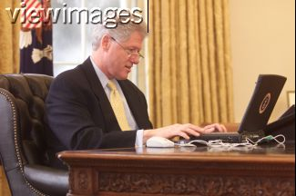
History of the internet
1993 - The WWW Revolution truly begins
The White House opens its Web page and the President gets an e-mail address.
Business and Media really take notice of the Internet.
Mosaic takes the Internet by storm.
User Friendly Graphical Front End to the World Wide Web.
Develops into Netscape -- most popular WWW browser to date.

Slide 41
History of the internet
Mosaic
Released in 1993
First Internet Web Browser
First commercial software with graphical access to the content on the internet
Very slow
Did not handle loading pictures well

Slide 42
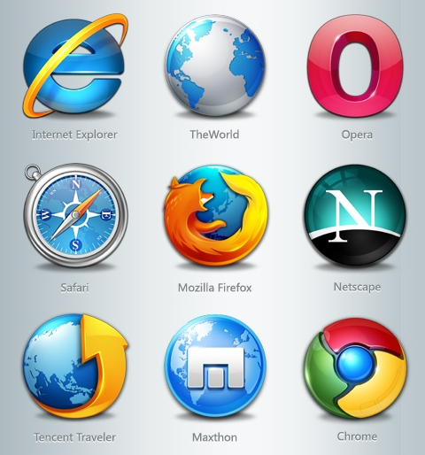
History of the internet
Browser Wars
Netscape was the standard until 1998.
Microsoft internet explorer snagged 96% of the browser market.
IE has only recently been challenged by the Mozilla browser and Google Chrome.

Slide 43
History of the internet
The explosion of the internet
1994 - 2000, internet exploded during this period.
The first commercial website amazon.com.
In 1994 the world wide web grew by an astounding 2300%.
Amazon saw the online shopping was the wave of the future.
The rest is history.

Slide 44
History of the internet
Internet Stats
1996 – Approx. 45 million people using internet
1999 – 150 million users
2000 – 407 million users
2004 – between 600 – 800 million users
2009 – more than 1.5 billion users and increasing
2016 – (Mid 2016) Around 4.4 billion users

Slide 45
Wake up Quiz
1. The three major players behind the creation of internet are____?
2. The major reason behind the creation of internet is__?
3. The year internet come to life is____?
4.The first web browser is__?
5.Can the internet withstand the atomic bomb ?how?

Slide 46
Summery
1969--The Birth of the Internet,ARPANET computer network is launched, initially linking together four scientific institutions in California and Utah
1972--E-mail Program developed by Ray Tomlinson in 1972
1983 ---ARPANET adopted tcp/ip that lead a way to become the modern internet
In 1984---the development of domain name services
In 1990, Tim Berners-Lee coined the term www
First web server
First web browser called worldwideweb
Web page
In 1993--Mosaic---first worlds popular browser,

